Slide 1
100% Export oriented knit garments manufacturer & buying agent
License address : 31, MOJID KHANPUR,NARAYANGANJ-1400,BANGLADESH

Slide 2
About us
Saraf Fashion is a buying House and 100% export oriented knit garments manufacture & Buying Agent. This is running with very well reputation in home and as well as abroad in this short time only for my sincere and my commitments. This company ensures you the best shrinkage control guaranty in knit garments by using the world best modern equipment's for knit garments. Our own factory name is Jazira Fabrics which one situated in Narayanganj and details of this factory is mentioned in factory profile and also mentioned our associate factories.
Saraf Fashion is also ensures that, the entire goods, which they produces are absolutely with out engagement of child labor and with out using any harmful substances for human being. We produced our all products with certified company by ISO, ACCORD, SEDEX, BSCI and others.
Beside this, for the consciousness of safe environment” Saraf Fashion is the sincere company who take the vital steps to prevent the environment from the waste and other industrial harmful substance.
RE-MARKS
You are always welcome to visit our company.
Please do not hesitate to ask us if you need to know any further information about us.

Slide 3
Team of Saraf Fashion
Merchandising Department
Employees of Merchandising Department | 12 persons are working Here
Our entire all merchandising job is controlled authentically by Shahadath Hossain Biplov.
2....) Quality Department
Employees of quality department | 15 persons are working here
All employees of this department are working according the instruction from merchandising department as per buyers required quality. This department make sure that the factory making the goods as required quality like shrinkage, colorfastness and others. .....................
Notes:
Our Quality Department :

Slide 4
Sample section Department of Saraf Fashion
Technical Hand for sample
Here has a technician department with skill and sincere peoples whose develop the garments workmanship which comment our clients after sending 1st sample /PP sample. And they apply it at factories operators so that they can sewing the garments as our clients comments on sending sample.
OUR VALUABLE BUYERS
1) Big star sp zoo(Poland) 2) SMYK (POLAND) OTCF S.A/4F SPONSOR (POLAND)

Slide 5
Contact Person of Saraf Fashion
Supplier's name | Saraf Fashion
Contact Person | Biplov
Mobile number | (+880) 7634421
E-mail | biplov@saraffashionbd.com
Web | www.saraffashionbd.com

Slide 6





Our ASSOCIATE FACTORY
Below mentioned factories is our associated which of them are OEKO-TEX, ACCORD, SEDEX ,BSCI audit updated. Our Qc team always time to give instruction in order to improve their quality .
For this , we can control the quality as per buyer requirements. Not only that , we control the knitting and dying also for keeping in tolerance of shrinkage.
1..) MARTIN KNITWEAR LTD
2..) JAZIRA FABRICS
3..) RS KNITWEARS LTD
4..) F K TEXTILE MILLS
5..) MODISH ATTIRES LTD
Notes:
Our Quality Department :

Slide 7
OUR SOURCING PRODUCTS
KID’S WEAR
MEN’S WEAR
LADIE’S WEAR
ALL OVER KNITWEAR ITEM LIKE AS :
T-SHIRT/POLO SHIRT/LEGGINGS/ROMPER

Slide 8
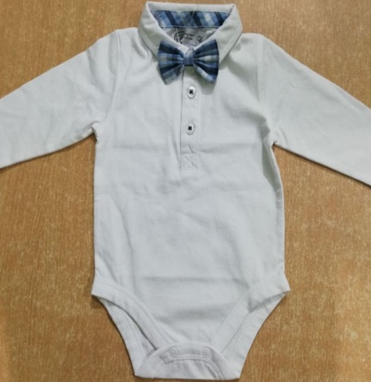
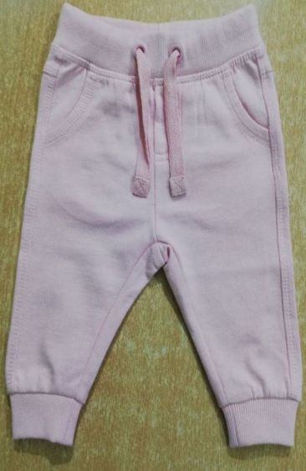
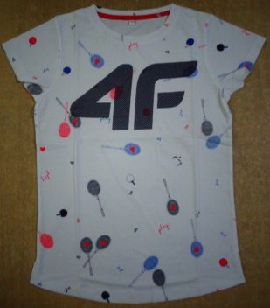
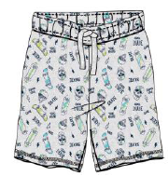
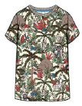
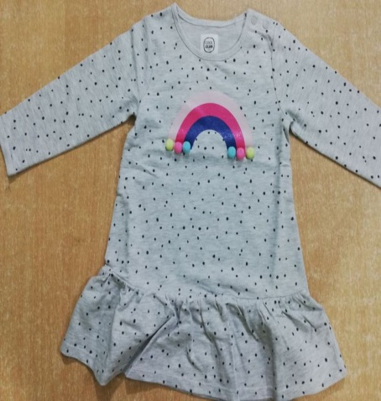
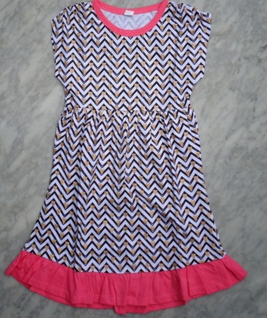

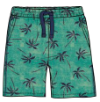
KID’S WEAR
BABY TO BIG BOY AND GIRL

Slide 9
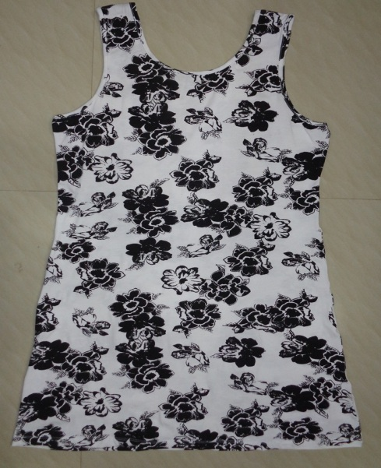
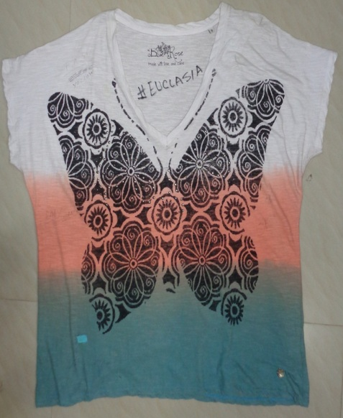
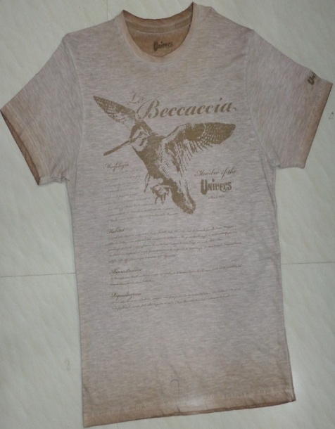
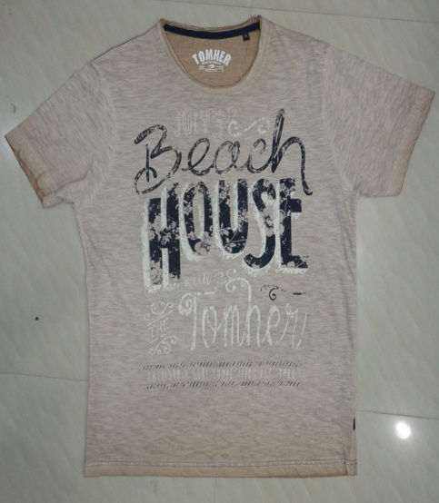
FOR LADIES AND MEN’S WEAR

Slide 10
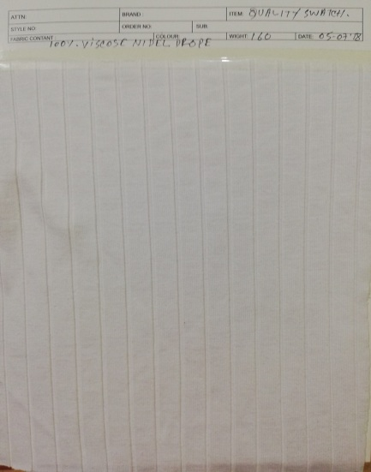
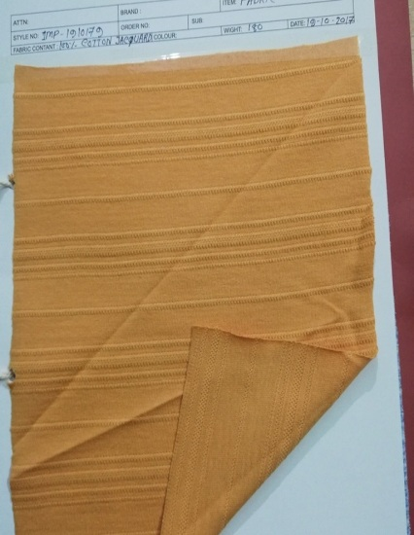
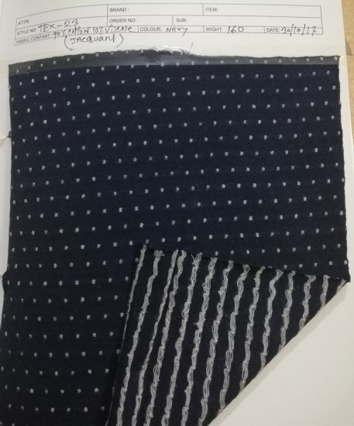
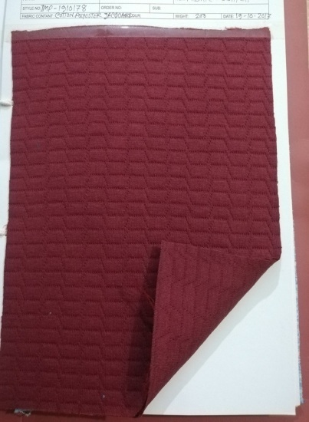
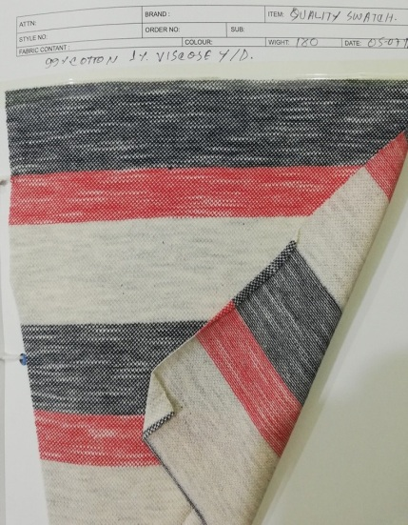
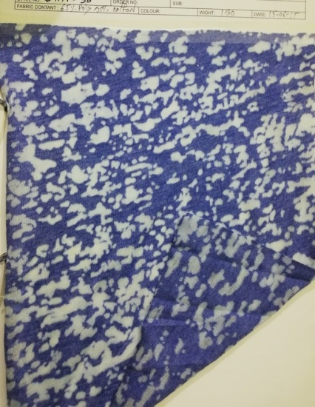
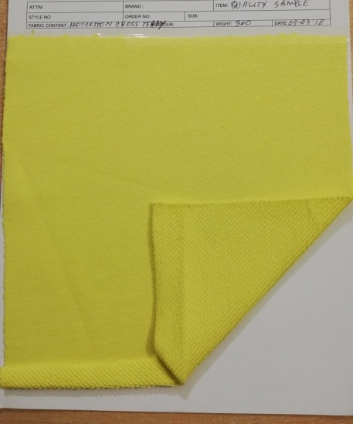
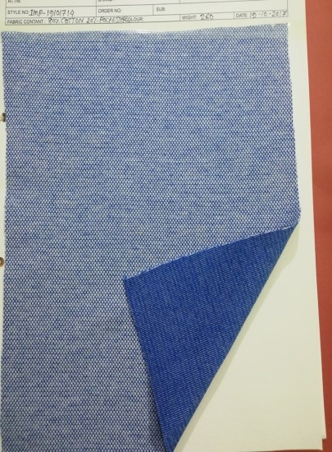
KNITWEAR FABRICS

